Slide 1
Statistics for Linguists
2022-11-28
Adam J.R. Tallman

Slide 2
Class projects
Arrange a time to meet with me, this or next week.
I can meet online.

Slide 3
Make up class
Are people free on Friday?
When?

Slide 4
Questions
Are there any questions?
Mean, median, standard deviation, variance / error
T-test
F-statistic
ANOVA
P-values
Problems with p-values

Slide 5
Questions
Things we’re ahead on:
ANOVA and linear models
I did this first because of the papers people submitted.
Things we are behind on:
The chi-squared test and Bayes’ rule

Slide 6
Today
Chi-squared test
Linear models and ANOVA

Slide 7
What we are building up to
Multivariate regression
Interactions
Causal inference

Slide 8
Chi squared test and p-values

Slide 9
Counts & contingency tables
A lot of statistical information comes from counts (e.g. frequency of words in different texts)
The data are usually presented in a contingency table.
Data from Matthew Dryer (1992)
OV = Object-Verb words order / VO = Verb-Object word order
Postp = positions / Prep = prepositions
H1:postpositions are associated with OV word order and prepositions are associated with VO order

Slide 10
Contingency table (word order associations)
 | OV | VO
Postp | 107 | 12
Prep | 7 | 70

Slide 11
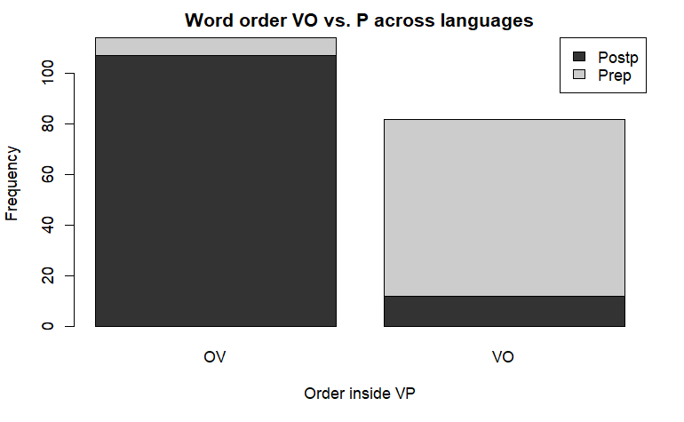

Slide 12
Counts and probabilities
These are observed frequencies
We now need a model that predicts the expected frequencies
Using these data, what is the probability of a random language from this sample having OV?

Slide 13
Counts and probability
wordorder <- cbind(c(107, 7), c(12, 70))
rownames(wordorder) <- c("Postp", "Prep")
colnames(wordorder) <- c("OV", "VO")
wordorder <- rbind(wordorder, c(114,82))
wordorder <- cbind(wordorder, c(119,77,196))
rownames(wordorder) <- c("PostP", "Prep", "Column Total")
colnames(wordorder) <- c("OV", "VO", "Row total")
wordorder

Slide 14
Expected Frequency
Raw total (Postp = 119, Prep = 77)
Column total (OV = 114, VO = 82)
Grand total = 196
Expected = (Raw total * Column total) / Grand total

Slide 15
Expected frequency
The expected frequency refers to what the values would be if VO/OV and Postp/Prep were independent.
 | OV | VO
Postp | (114*119)/196 | (82*119)/196
Prep | (114*77)/196 | (82*77)/196

Slide 16
Expected frequency
What we’ve done is created a hypothetical “null distribution” against which we can measure how surprising our actual data are.
 | OV | VO
Postp | 69.21429 | 49.78571
Prep | 44.78571 | 32.21429

Slide 17
Expected frequency vs. real frequencies
What we’ve done is created a hypothetical “null distribution” against which we can measure how surprising our actual data are.
 | OV | VO
Postp | 69.21429 | 49.78571
Prep | 44.78571 | 32.21429
 | OV | VO
Postp | 107 | 12
Prep | 7 | 70

Slide 18
Expected frequency vs. real frequencies
Its clear that the expected and the observed are different
But because of errors in sampling there is always some variation, so we are interested in whether the expected frequencies are significantly different
 | OV | VO
Postp | 69.21429 | 49.78571
Prep | 44.78571 | 32.21429
 | OV | VO
Postp | 107 | 12
Prep | 7 | 70

Slide 19
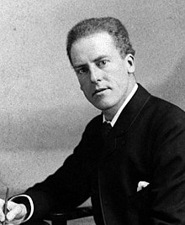

Chi-squared test
The classical way of doing this is Karl Pearson’s chi-squared test.
$$χ^{2}=\sum{\frac{{\left(Observed−Expected\right)}^{2}}{Expected}}$$

Slide 20
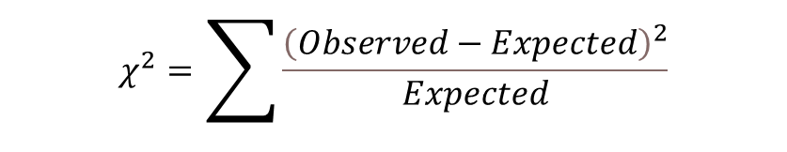

E <- cbind(c((114*119)/196, (114*77)/196),
c(82*119/196,(82*77)/196))
rownames(E) <- c("Postp", "Prep")
colnames(E) <- c("OV", "VO")
E
$$Expected=\frac{Rowtotal∗Columntotal}{Grandtotal}$$
E.df <- melt(E)
colnames(E.df)<-c("Adposition", "Verb.Object", "Expected.Frequency")
E.df$Observed.Frequency <- wordorder.df$Frequency
E.df
Putting expected and observed data in the same data set
E.df$oe <- ((E.df$Observed.Frequency - E.df$Expected.Frequency)^2) / E.df$Expected.Frequency
E.df
sum(E.df$oe)
$$χ^{2}=\sum{\frac{{\left(Observed−Expected\right)}^{2}}{Expected}}$$

Slide 21
Chi-squared test and p values
Is this number big?
What is the critical value of the chi-squared test?
To calculate this, we need the degrees of freedom and the cut off area you want.
R = number of rows
C = number of columns

Slide 22
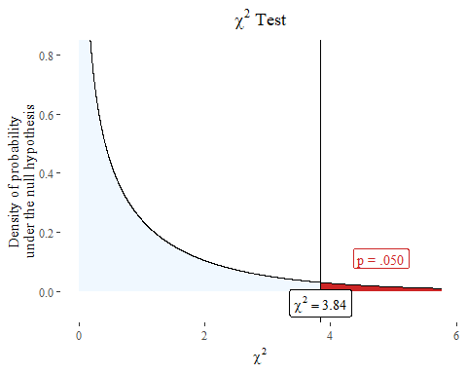
Chi-squared test and p-value
We have another hypothetical distribution based like the t distribution.

Slide 23
Linear models

Slide 24
What is regression?
T-test is used when the dependent variable is continuous and the independent variable is categorical.
Chi-squared test can be used when all of your variables are categorical.
Regression analysis can be used when the dependent and independent variables are continuous.
(Logistic) regression analysis (next week?) is used when the dependent variable is binary or ordinal and the independent variable is continuous.

Slide 25
What is regression?
T-test is used when the dependent variable is continuous and the independent variable is categorical.
Chi-squared test can be used when all of your variables are categorical.
Regression analysis can be used when the dependent and independent variables are continuous.
(Logistic) regression analysis (next week?) is used when the dependent variable is binary or ordinal and the independent variable is continuous.

Slide 26
Regression analyses in linguistics
Morphosyntax: Relationship between phonological complexity and morphological complexity. (Easterday et al. 2021)
Phonology: The shape and direction of a pitch contour over time.
Language acquisition: Age against vocabulary acquisition (or any measure of language proficiency)
Psycholinguistics: Reaction time against frequency of the word.

Slide 27
Regression analysis
Model choice: When you do a regression analysis you have to decide on what the relationship should be.
What are the different types of relationships two continuous variables can have with one another?

Slide 28
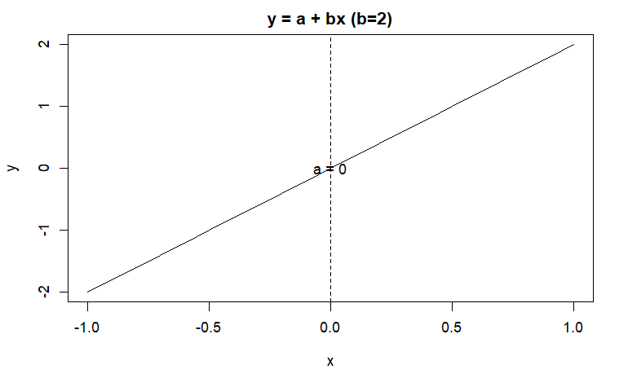
Simple linear model
a is the intercept
b is the coefficient
Y is the dependent variable
X is the independent variable

Slide 29
Exponential function
Will it still be a straight line if it looks like this?
$$y=a+bx^{2}$$

Slide 30
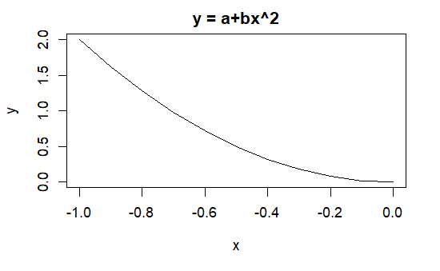
Exponential curve
$$y=a+bx^{2}$$

Slide 31
And this?
$$y=a+bx^{2}$$

Slide 32
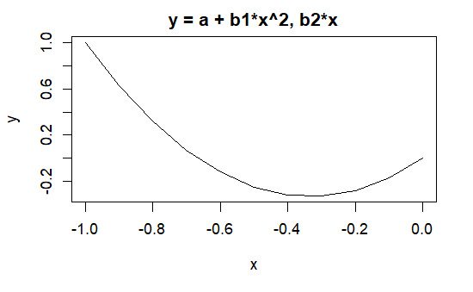
Parabolic curve
$$y=a+b_{1}x^{2}+b_{2}x$$

Slide 33
Model choice
Part of “model choice” is what type of relationship you think x and y display with one another.
Note that the interpretation of the coefficient b / β could be very different depending on the type of model you have.

Slide 34
Calculate ‘b’
To understand the values of a linear model, we need to understand first the meaning of b.

Slide 35
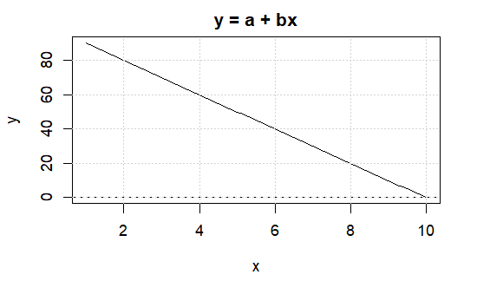
Calculate ‘b’

Slide 36

Calculate ‘b’

Slide 37
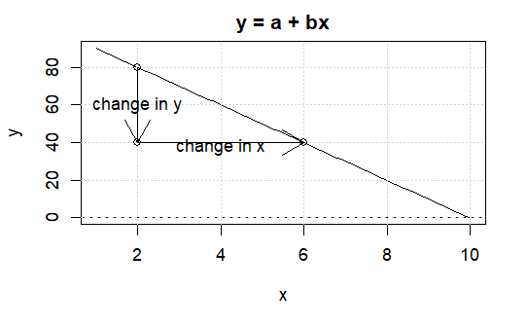
Calculate ‘b’

Slide 38
Word length and reaction times
For some reason, the Rling package of Levshina doesn’t work for recent installations of R.
So you can download it from github following the instructions provided by Levshina.

Slide 39
Word length and reaction times
## Length Freq Mean_RT ## Min. : 3.00 Min. : 0.0 Min. : 564.2 ## 1st Qu.: 6.00 1st Qu.: 53.5 1st Qu.: 713.1 ## Median : 8.00 Median : 310.5 Median : 784.9 ## Mean : 8.23 Mean : 3350.3 Mean : 808.3 ## 3rd Qu.:10.00 3rd Qu.: 2103.2 3rd Qu.: 905.2 ## Max. :15.00 Max. :75075.0 Max. :1458.8

Slide 40
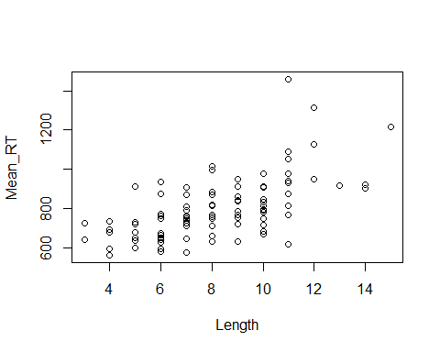

Slide 43
lm(Mean_RT~Length)
## ## Call: ## lm(formula = Mean_RT ~ Length) ## ## Coefficients: ## (Intercept) Length ## 498.44 37.64

Slide 44
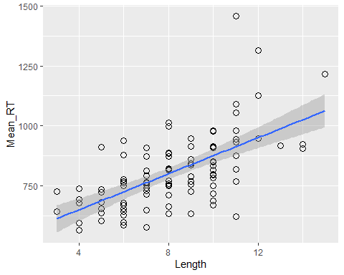
ggplot(ldt, aes(x=Length, y = Mean_RT))+
geom_point(shape=1, size=3)+stat_smooth(method=lm)

Slide 45
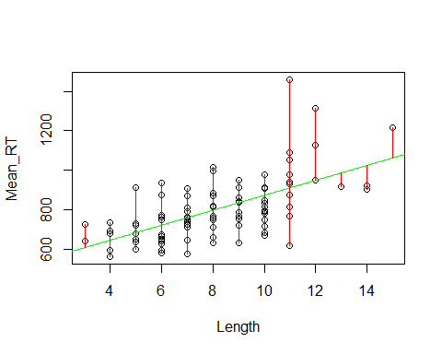
Residuals
A residual is the difference between each data point and the value predicted by the model at the same value of x.
Some residuals are positive and others are negative.

Slide 46
Residuals
$\hat{y}$ refes to the predicted value.
d refers to the residual of a specific data point.
$$d=y−\hat{y}$$
$$d=y−\left(a+bx\right)$$
$$d=y−a+bx$$

Slide 47

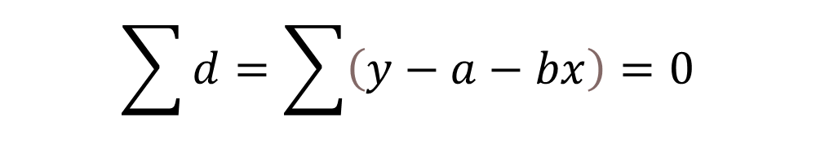
Residuals
A regression calculates a line with interpret and slope that make the sum of the residuals equal to 0 (or as close to 0 as possible)
$$\sum{d}=\sum{\left(y−a−bx\right)}=0$$
$$SSE=\sum{d^{2}}$$

Slide 48
Residuals
Imagine guessing what the slope.
After this we change the value of the slope.
Then we work out the new intercept $ a = y -bx - d $.
Then we predict the fitted values of y (reaction time) for the new b.
After this we work out the residuals
Then we calculate the SSE.
Then we repeat for values of b until we arrive at the smallest number.

Slide 49
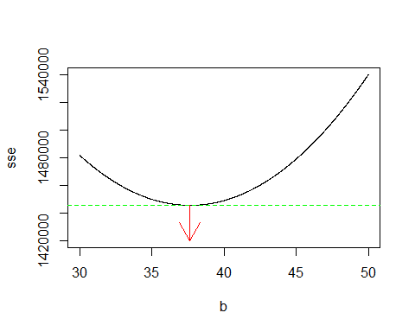
Residuals

Slide 50
Residuals
We get the same result with lm()
lm(Mean_RT~Length)
## ## Call: ## lm(formula = Mean_RT ~ Length) ## ## Coefficients: ## (Intercept) Length ## 498.44 37.64

Slide 51
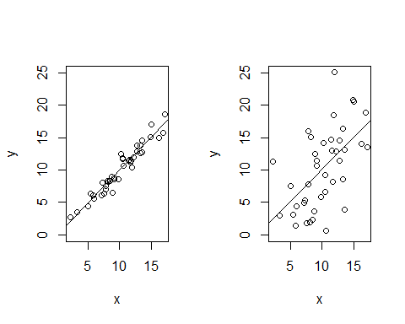
Model fitting
Two regression lines can have the same slope and intercept, but be different with respect to their residuals.

Slide 52
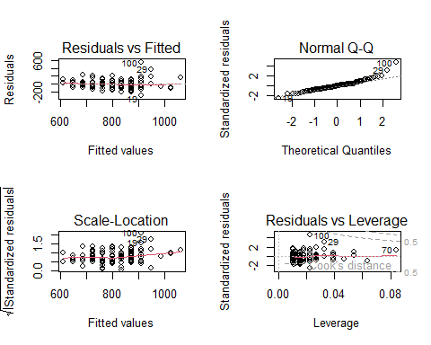
Model checking

Slide 53
ANOVA
What is typically referred to as ANOVA (Analysis of variance) often refers to a type of statistical analysis when all the predictor variables categorical. There is some controversy with respect to whether ANOVA can just be understood as a special case of regression analysis. Compare
Cottingham et al. 2005 ``Regression versus ANOVA” in Frontiers in Ecology and the Environment
Gelman 2006 ``Analysis of variance - why it is more important than ever” in The Annals of Statistics

Slide 54
ANOVA and Regression
ANOVA has the same mathematical structure as regression,but some regard it as conceptually different,
ANOVA can also mean the analysis of data into batches and groups (hierarchical modeling), rather than narrowly as the classical ANOVA test.
For historical reasons the ANOVA is more often used in experimental settings and regression analysis for observational data.
Sometimes classical ANOVA is used, when regression really should be: the research bins the data of the predictor variable into groups to make it categorical (see Stoll & Gries 2009) in Journal of Language Acquisition.

Slide 55
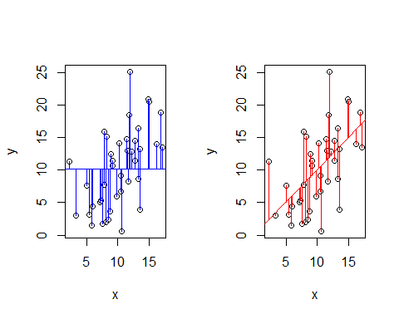
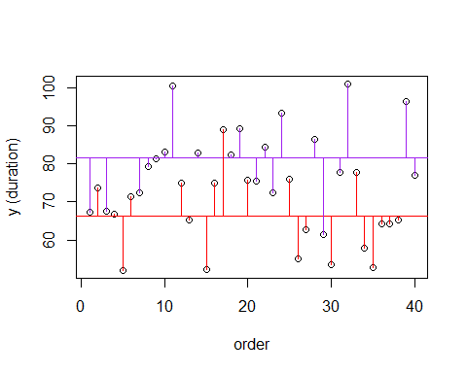
ANOVA and regression

